Slide 1
Post Secondary
CALM 20

Slide 2
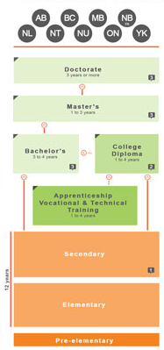

Slide 3
What are your plans after High School?
Work?
University/College?
If you plan on going to a Post Secondary Institution here’s what you need to know….

Slide 4
What do you want to take at a post secondary institution?
What are the admission requirements?
Where do you wish to work afterwards?
Does location matter?
How much money do you or your family have saved for post secondary education?

Slide 5
How long does the program take?
How reputable is the post secondary institution?
What attractions or extras will the post secondary institution give you?

Slide 6
Post Secondary Schools in Alberta
http://www.albertacanada.com/opportunity/living/education-post-secondary.aspx
http://alis.alberta.ca/ec/ep/pps/planning.html

