Slide 1
Creative Thinking
CALM 20

Slide 2
What is Creative thinking?
A way of looking at problems or situations from a fresh perspective that suggests unorthodox solutions.
Creative thinking can be stimulated both by an unstructured process such as brainstorming, and by a structured process such as lateral thinking

Slide 3
Why is being able to Creatively think beneficial?
Ability to look at problems differently
Why else…
Employment?
Relationships? Communication?

Slide 4

Do you think you are a Creative thinker?

Slide 5
Let’s Challenge our Creative thinking!
Paper Clip
The test measures divergent thinking across four sub-categories:
  Fluency – how many uses you can come up with
  Originality – how uncommon those uses are (e.g. “router restarter” is more uncommon than “holding papers together”)
  Flexibility – how many areas your answers cover (e.g. cufflinks and earrings are both accessories, aka one area)
  Elaboration – level of detail in responses; “keeping headphones from getting tangled up” would be worth more than “bookmark”

Slide 6
Let’s Challenge our Creative thinking!
Complete the Picture on the Handout
Developed in the ’60s by psychologist Ellis Paul Torrance, the Torrance Test of Creative Thinking (TTCT) sought to identify a creativity-oriented alternative to IQ testing.

Slide 7
Let’s Challenge our Creative thinking!
Riddles..
Three couples went together to a party. One woman was dressed in red, one in green, and one in blue. Each man was wearing one of these colors. When all three couples were dancing, the man in red was dancing with the woman in blue. "Isn't it funny Christine, not one of us is dancing with a partner dressed in the same color." Think about the man who is dancing with the woman in red. What color is he wearing?
Psychologists use riddles to measure creative problem solving potential, or convergent thinking.
Notes:
Answer: Green. Since the man in blue is dancing with the woman in red the man in green has the choice of either the woman in red or green (he cannot dance with green so he is dancing with the woman in red).

Slide 8
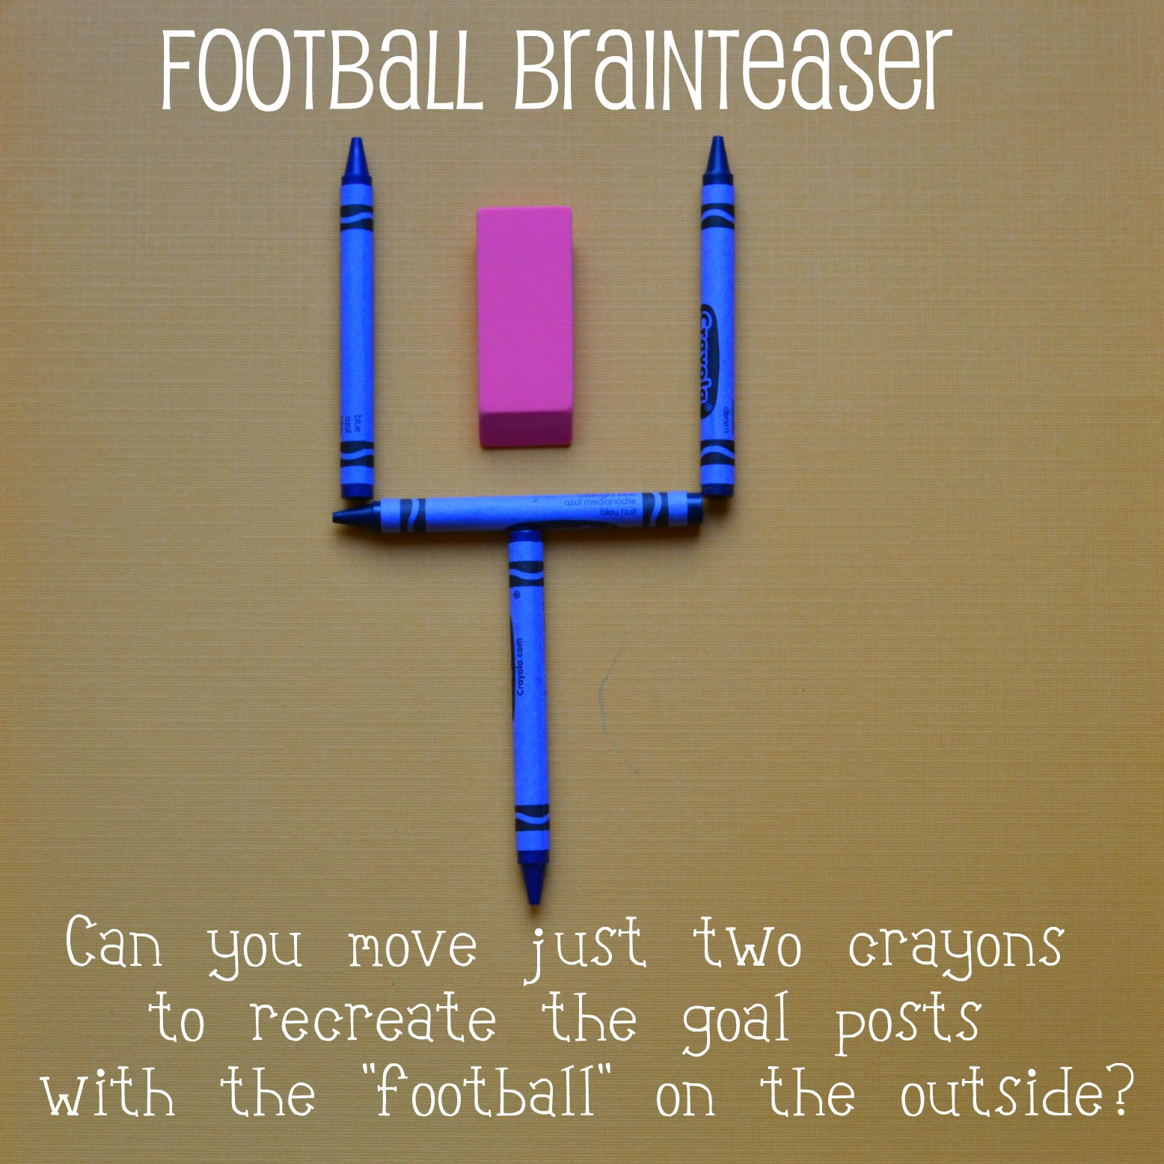
Let’s Challenge our Creative thinking!

Slide 9
How does this relate to real life?
Take out a blank piece of paper.
Write a short paragraph about:
  How Creative thinking can enhance your wellness dimensions (any or all dimensions)
  When in your week so far have you had to use creative thinking skills? Give an example and explain how you used your creative thinking skills

