Slide 1
Life Long Learning
CALM 20

Slide 2
Life Long Learning
Lifelong learning is defined as “all learning activity undertaken throughout life, with the aim of improving knowledge, skills and competences within a personal, civic, social and/or employment-related perspective”.

Slide 3
What are characteristics of an effective learner?
What does an effective learner do??

Slide 4
What type of a Learner are you?
Learner Quiz

Slide 5
Learner Types
Now knowing what type of Learner you are, explain some techniques you could use to help your be successful in learning
Write on the back of your learner type quiz 3 strategies you could use to learn that would be beneficial based on your learner type
Ex. Auditory: Record Lectures and replay them to learn information

Slide 6
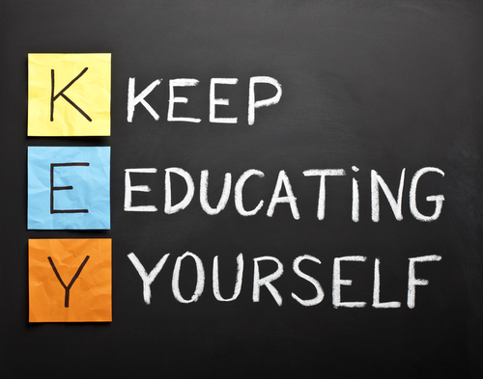
Why be a life long learner?
Through our lives we are going to encounter events that will require us to think Critically- with more knowledge we will be able to look at problems with various different views.

Slide 7
What can we do to be a life long learner?
Challenge ourselves to learn something new!
Take new Classes
Start a new hobby
Join a new group/organization
Read
Research

Slide 8
How can we manage….
Procrastination
Time Management
How can we overcome these while learning??

Slide 9
Skills You Need
http://www.skillsyouneed.com/learn/lifelong-learning.html

