Slide 1
Physical Dimension: Eating Healthy
CALM 20

Slide 2
What is in our Food?
When we look at a food label, what do we see?
2005- Food Labels Mandatory
They provide the following information:
the nutrition facts table
ingredient list
nutrition and health claims

Slide 3
What food products have Nutrition Facts?
Almost all prepackaged foods have Nutrition Facts.
Some exceptions are:
fresh fruit and vegetables;
raw meat, poultry, fish and seafood;
foods prepared or processed at the store:
bakery items, sausage, salads;
foods that contain very few nutrients:
coffee beans, tea leaves, spices;
alcoholic beverages.

Slide 4
Measurements
Most nutrients are measured in grams, also written as g. Some nutrients are measured in milligrams, or mg. Milligrams are very tiny — there are 1,000 milligrams in 1 gram.

Slide 5
Other information on the label is given in percentages. Food contains fat, protein, carbohydrates, and fiber. Food also contains vitamins, such as A and C, and minerals, such as calcium and iron.
The percent daily value on a food label tells you how this food can help someone meet these daily goals. (On food labels, they base the percentages on a 2,000-calorie adult diet)

Slide 6
Ingredient List…
Ingredients are listed in order so you get an idea of how much of each ingredient is in the food.
When something is listed first, second, or third, you know that this food probably contains a lot of it.
The food will contain smaller amounts of the ingredients mentioned at the end of the list.

Slide 7
Tricky Tricky…
Sugar has different names, so it might also be called high fructose corn syrup, corn syrup, sucrose, or glucose.

Slide 8
Serving Size
The nutrition label always lists a serving size, (which is an amount of food, such as 1 cup of cereal or two cookies etc.)

Slide 9
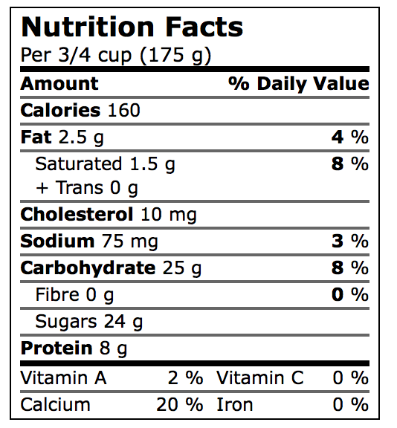
So, what do all the Nutrition Facts mean?

Slide 10
Calories
https://www.youtube.com/watch?v=VEQaH4LruUo
The name calorie is used for two units of energy. The small calorie or gram calorie (symbol: cal) is the approximate amount of energy needed to raise the temperature of one gram of water by one degree Celsius at a pressure of one atmosphere.

Slide 11
Daily Value (DV%)
The % DV is found on the right-hand side of a nutrition facts table. It is a guide to help you make informed food choices. It shows you if the serving size has a little or a lot of a nutrient:
5% DV or less is a little
15% DV or more is a lot
This applies to all nutrients with a % DV.

Slide 12
How percent daily value is calculated
Many of the nutrient amounts in the nutrition facts table are shown using % DV.
The current daily values in Canada are based on 2 sets of values. The % DV for a nutrient is calculated by:
dividing the amount of a nutrient in a serving size by its daily value, then
multiplying that number by 100
For example, a food product has 3 mg of iron. The daily value for iron is 14 mg. This means that the % DV for iron would be 21%.
If you would like to do your own calculation, use the equation below to help you.
(3 mg ÷ 14 mg) × 100 = 21% DV
Daily values are as followed in the chart below:
Nutrient Daily Value (DV)
Fat 65 g
Saturated and trans fats 20 g
Cholesterol 300 mg
Sodium 2400 mg
Carbohydrate 300 g
Fibre 25 g
Sugars no DV
Protein no DV
Vitamin A 1000 RE
Vitamin C 60 mg
Calcium 1100 mg
Iron 14 mg

Slide 13
Fat
Fat is an important nutrient for your health. Fat plays many different roles in the body:
It gives you energy (also called calories).
It helps your body absorb vitamins A, D, E and K.
It helps your body grow and develop.
There are many different kinds of fat in foods:
Unsaturated such as monounsaturated fat and polyunsaturated fat
Saturated
Trans

Slide 14
Types of Fat
Unsaturated fat is a type of fat found in the foods you eat. Choose unsaturated fat as part of a balanced diet using Canada’s Food Guide.
Replacing saturated and trans fats with unsaturated fats has show to help lower cholesterol levels and reduce the risk of heart disease.
Where can you find monounsaturated fat?
Avocados
Nuts and seeds
Vegetable oils such as canola, olive, peanut, safflower, sesame, sunflower
Where can you find polyunsaturated fat?
Fatty fish such as herring, mackerel, salmon, trout
Nuts and seeds
Vegetable oils such as canola, corn, flaxseed, soybean, sunflower

Slide 15
Types of Fat
Saturated fat is a type of fat found in food. It has been shown to raise LDL or "bad" cholesterol levels. High LDL-cholesterol is a risk factor for heart disease.
Saturated fat is found in many foods:
Animal foods such as beef, chicken, lamb, pork, veal
Coconut, palm and palm kern oils
Dairy products such as butter, cheese, whole milk and other dairy products
Lard
Shortening

Slide 16
Types of Fat
Until recently, most of the trans fat found in a typical Canadian diet came from margarines, commercially fried foods and bakery products that were made with shortening, margarine or oils containing partially hydrogenated oils and fats.
These products included cakes, cookies, crackers, croissants, doughnuts, fried and breaded foods, muffins, pastries and other snack foods. The food supply is rapidly changing and the trans fat content of many of these products has now been reduced

Slide 17
Canada’s Food Guide
Make a better choice for you. Here are some nutrients you may want…
more of…
Fibre
Vitamin A
Calcium
Iron
less of…
Fat
Saturated and trans fats
Sodium

Slide 18
Vegetables & Fruit
Eat at least one dark green and one orange vegetable each day.
Choose vegetables and fruit prepared with little or no added fat, sugar or salt.
Have vegetables and fruit more often than juice.

Slide 19
Grain Products
Make at least half of your grain products whole grain each day.
Choose grain products that are lower in fat, sugar or salt.

Slide 20
Milk & Alternatives
Drink skim, 1%, or 2% milk each day (or fortified soy beverages).
Select lower fat milk alternatives

Slide 21
Meat & Alternatives
Have meat alternatives such as beans, lentils and tofu often.
Eat at least two Food Guide Servings of fish each week.
Select lean meat and alternatives prepared with little or no added fat or salt.

Slide 22
Oils & Fats
Include a small amount -
30 to 45 mL (2 to 3 Tbsp) -
of unsaturated fat each day.
Use vegetable oils such as canola, olive and soybean.
Choose soft margarines that are low in saturated and trans fats.

