Slide 1
Paycheques and bank accounts
CALM 20

Slide 2
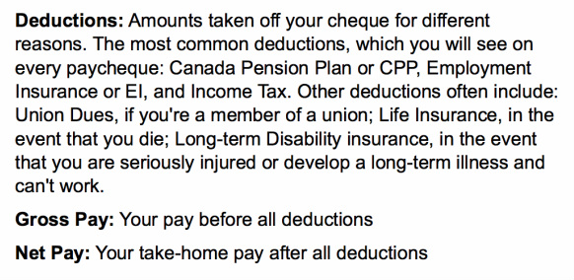
Paycheques, definitions to know…

Slide 3
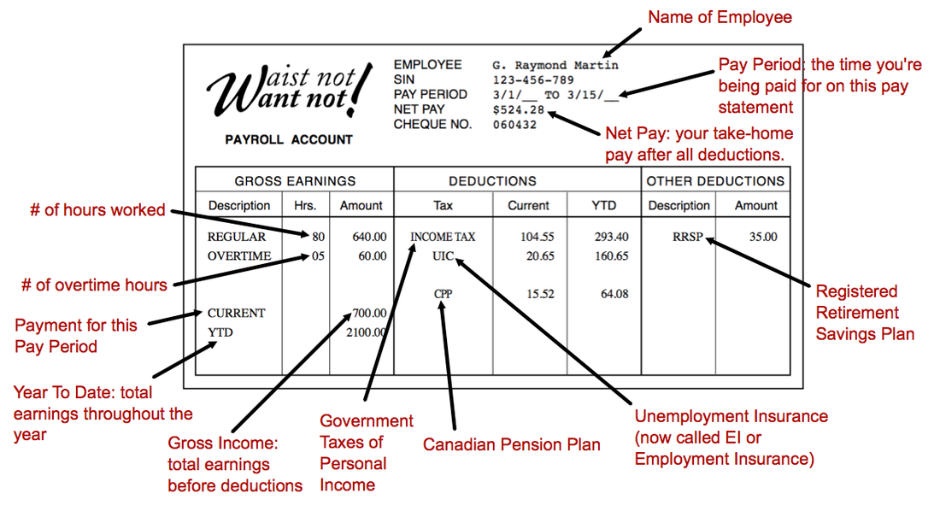

Slide 4
Analyze Paystubs
Worksheet
Use the paystubs information to fill out your worksheet

Slide 5
Bank Accounts
Basic Banking
Financial Institution: An organization that provides banking or other financial services for customers. Banking, refers to the services offered (deposits, loans, etc.)
Banks are regulated by the government of Canada, and credit unions can choose to be federally regulated.

Slide 6
Definitions
Account: An arrangement with a financial institution to let you deposit, transfer and withdraw money, subject to terms that are defined in the account agreement
Savings Account & Chequing Account: Are the two main types of deposit accounts
Account Agreement: An agreement that lists your rights and responsibilities and the financial institutions rights and responsibilities regarding the account
Transaction: Any business done through your account, such as a deposit, cash withdrawal, a cheque or a bank charge

Slide 7
Deposit Services
You deposit your money at a financial institution to keep it safe until you need it
When you deposit money into an account, some financial institutions may pay you interest (different Institutions different interest rates)
Make sure you look around and compare!

Slide 8
Accounts
Savings Account- Can pay higher rates of interest than other bank accounts, but may have extra charges (ex. Withdrawal)
Chequing Account- Pay low interest or none, but you can write cheques, or withdraw money at any time

Slide 9
Card Services
Most financial institutions offer a card (debit card/bank card) that allows you to make transactions at a cash/bank machine.
You can use the Card 2 Main Ways:
Make deposits, withdraw cash, pay bills, transfer money
Pay for services/products at a store
There is a secret personal identification number (PIN) you use on the card. Make sure you keep this PIN a secret!

Slide 10
WebQuest
Financial Consumer Agency of Canada
http://www.fcac-acfc.gc.ca/Eng/Pages/home-accueil.aspx

Slide 11
Websites
Account Selector Tool: http://www.fcac-acfc.gc.ca/eng/resources/toolCalculator/banking/bankingPackage/BanStep1-eng.asp
TD Bank: http://www.tdcanadatrust.com/products-services/banking/index-banking.jsp
CIBC: https://www.cibc.com/ca/personal.html
Scotia Bank: http://www.scotiabank.com/gls/en/index.html#about
Royal Bank of Canada: http://www.rbcroyalbank.com/personal.html
Alberta Treasury Branch: http://www.atb.com/Pages/default.aspx
Bank of Montreal: http://www.bmo.com/home
President’s Choice Financial: http://www.pcfinancial.ca

Slide 12
How to Save Money
After paying expenses, set some income aside.
Saving Is Necessary! Unexpected events…

Slide 13
Step One: Reduce Expenses
Spend less on unnecessary items
Variable expenses (ex. Do you really need a new hoodie right now?)

Slide 14
Step Two: Make Saving a Habit
Take a small % from every paycheque, and save it
10% of your Income Is a good place to start
Automatic transfers to savings- Ask the Bank
Adds Up!

Slide 15
Step Three: Get your Money working for you!
Savings Account (interest)
The amount of interest usually depends on an annual percentage rate attached to your account, as well as the “principle” (which is the initial amount deposited
Leave savings untouched for as long as possible- You earn more interest!

Slide 16
25 Ways to Cut Your Spending and Save!
http://youtu.be/tu2AxAp1sl0
Other ways to Save
Mason Jar/ Piggy Bank
Direct Transfers
Budget!
Ideas?

Slide 17
Exit Slip
What Saving Technique will you use and why?

