Slide 1
Budgeting
CALM 20

Slide 2
Budgeting Food
Next to Rent/Mortgage , Food is the other area you will spend a large portion of your money
(average- 20% of Income)

Slide 3
Organizing a Shopping List
Having a list to begin with helps ensure you don't forget an important ingredient, and organizing by food category helps you move through the market/grocery store more efficiently
Meal Planning

Slide 4
Cost/ Values & Labels/Specials
Generic versus brand name?
Does is matter?
what size box of cereal?
Organic or not?
Bulk?
Buy in bigger quantities?

Slide 5
Coupons!
Are they beneficial?
Are they worth the time?
http://www.flipp.com/app

Slide 6
Tips and Tricks
Do not go grocery shopping on an empty stomach
Shop on a Wednesday Evening!
Do your homework on your “favorite Grocery Store” . Ex. 15% Tuesday
https://www.youtube.com/watch?v=CH43UIIgpNg

Slide 7
Making what you buy go the distance
Plan!
Prepare!
Budget!!

Slide 8
Weekly Menu & Grocery Example
Tuesday Supper
Chili and salad
Groceries:
I lb Ground beef
Brown beans (1)
Kidney beans (1)
Tomato soup (1)
Seasoning
Romaine lettuce
Tomato (2)
Mushrooms
Marble Cheese block
Bread

Slide 9
Task
Create a Week Menu (supper)- one meal only may be a take-out or Easy Meal (aka. KD)
Create a Grocery List based on the Menu
If you have time… start guessing how much each product on the list costs

Slide 10
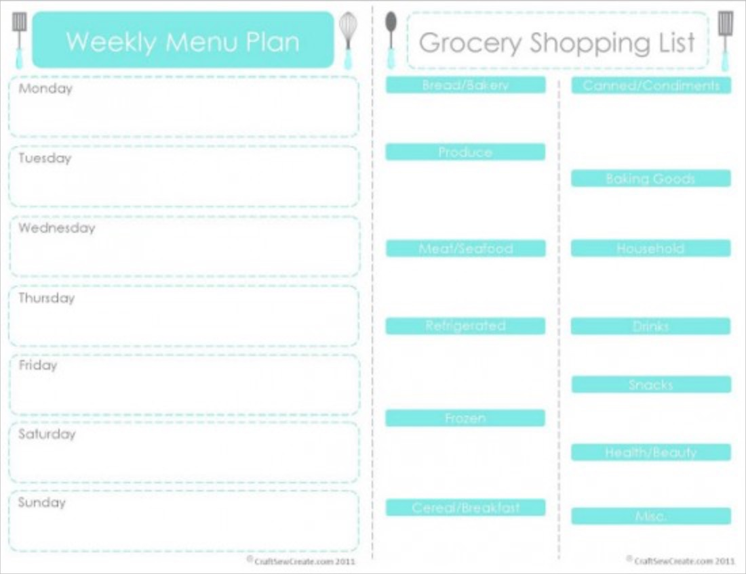

Slide 11
Exit Slip
Would you consider using a Menu/Grocery list? Why or Why Not?
Would you take time to coupon? Yes/No
(REMEBER!- Put your Name on it)

